Slide 1
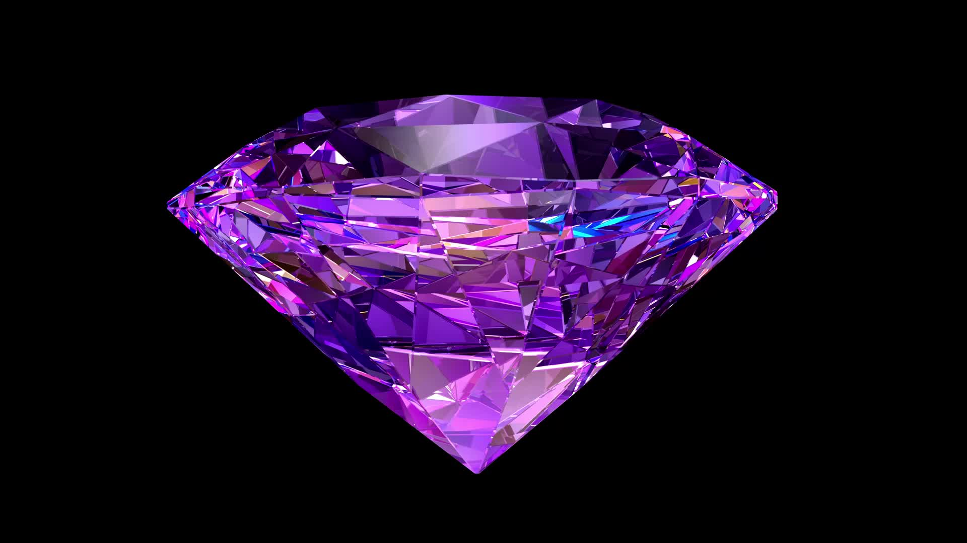
Diamonds
Santiago Bohorquez

Slide 2
Diamonds
This study aims to investigate the relationship between the price of diamonds and their carat size. This study will show us the best purchasing decision as a consumer.
The dataset used was found on Kaggle and was last updated five years ago.
To figure this out we will be using a linear regression model and a t–test.

Slide 3
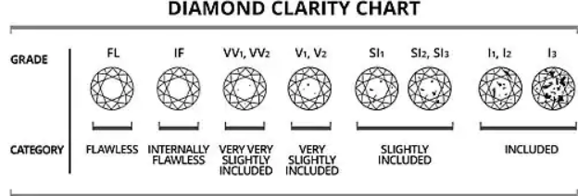
Data
The variables I will use for my study are the price of the diamonds and the carat size of the diamond
There are a total of 53,939 data entries in the data set.

Slide 4
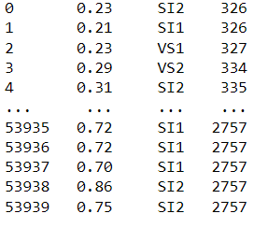
DATA

Slide 5
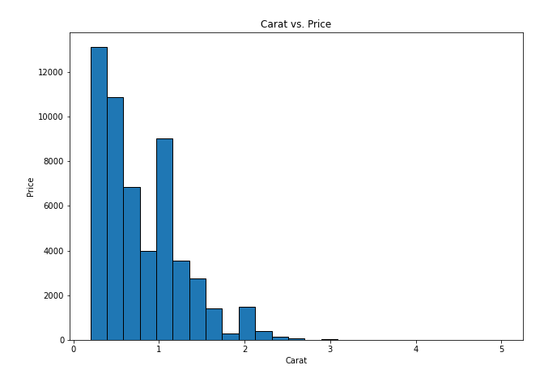
data

Slide 6
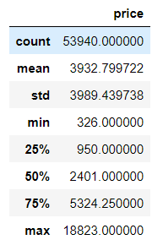
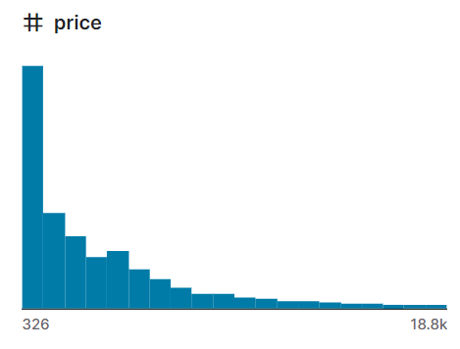
Data

Slide 7
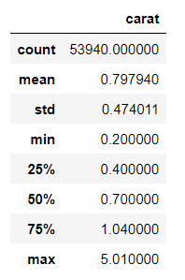
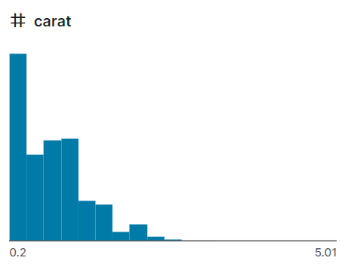
Data

Slide 8
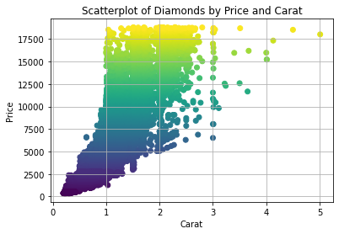
Methodology/Model

Slide 9
Methodology/model
Independent variable: Carat
Dependent variable: Price
R² = 0.8493 the two quantitative variables are strongly correlated price and carrot.
The two quantitative variables are strongly related, price and carrot. These two variables account for approximately 85 percent of the variation in the data. This also means there's is about a 15 percent variation in the data that has nothing to do with the price and carrot.
y = 7756.4x - 2256.4 (to estimate the price of the diamond you insert the carat size of the diamond into x)

Slide 10
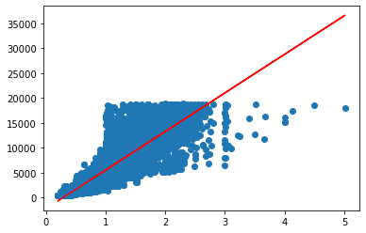
Least squares line

Slide 11
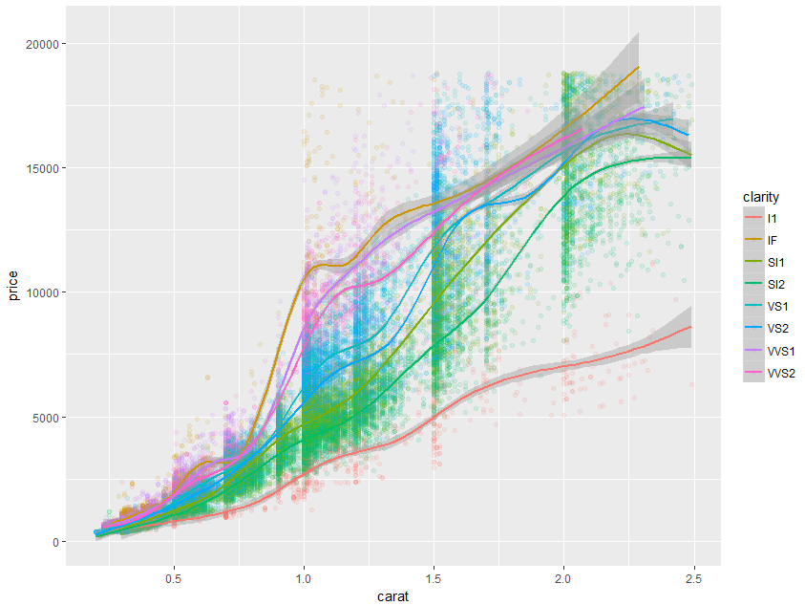
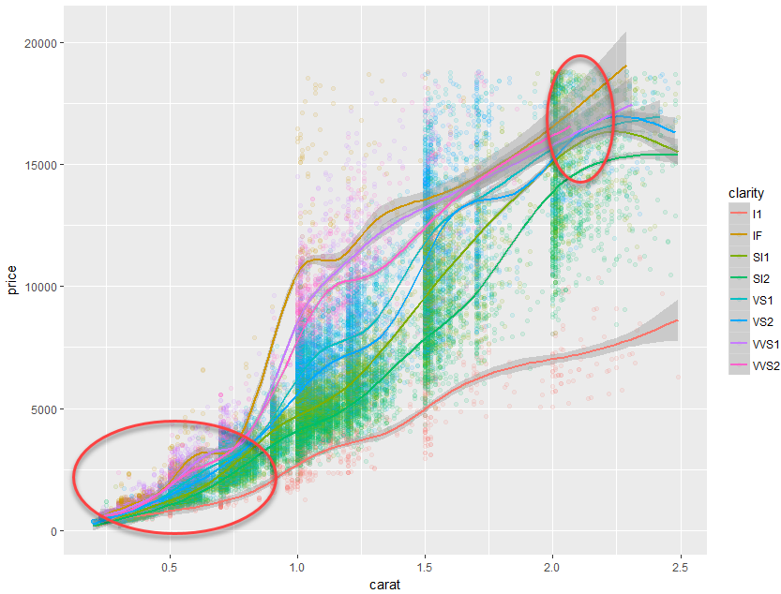
If I was a purchaser of diamonds, I may want to purchase a diamond that has a carat value of the areas circled in red. Buying diamonds of this carat gives me an opportunity of buying a diamond that has a mispriced lower value.

Slide 12
Conclusion
Diamonds with the highest clarity should be priced higher than those with lower clarity, given that the diamonds are of the same carat/weight.
Diamonds tend to be purchased at specific carat/weights(1.0, 1.5 ,2.0).
The higher the carat value, the less confidence we have in predicting price because we have fewer data points. Notice that the gray area gets larger as the carat size increases.
There are mispricing’s in the diamond market. On the plot, when the lines cross one another, it means there is a mispricing. There are two areas on the plot where mispricing is most likely, I have circled this in red.

